Slide 1

tradevance
A Trading and Market Status Advice Application
Group No. 2
Eric Hines
Isidro Leonyork
Ricky Mershad
Samuel Santo

Slide 2


Agenda
Goal of the Project
Components
Stocks transactions
Report about Portfolio
Comparison of Stocks
Market Sentiment
Market Cycles
Results

Slide 3


Introduction
The goal of the project is to implement an application that allows the user to manage a stock portfolio and provides analysis about the market, stocks and his/her portfolio.
The application takes advantage of an API provided by a company named Alpaca. This API allows you to do stocks, index and crypto trading.

Slide 4

Taking advantage of Python and its libraries to manipulate big data, we can obtain a lot of market information, make a particular selection of the data needed and make insightful presentations of the results.
We take advantage of effective integration of Python and SQL to store persistent and historical data in a secure manner.
We also take advantage of the yahoo finance package functionality that is integrated with the Python ecosystem.

Slide 5

We plan to evolve the application in future project stages by adding Web 3.0 functionality such as doing crypto transaction implementing Ethereum blockchain to perform proof of stake.

Slide 6
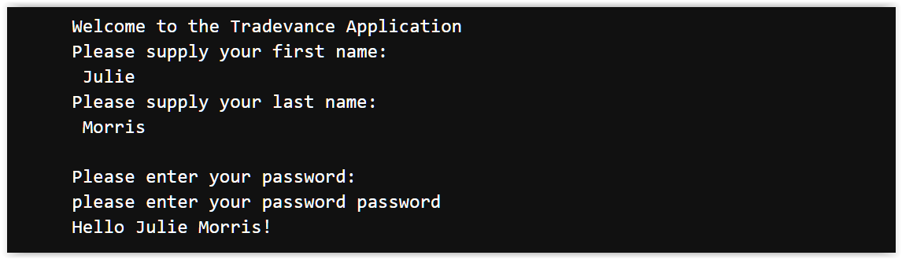
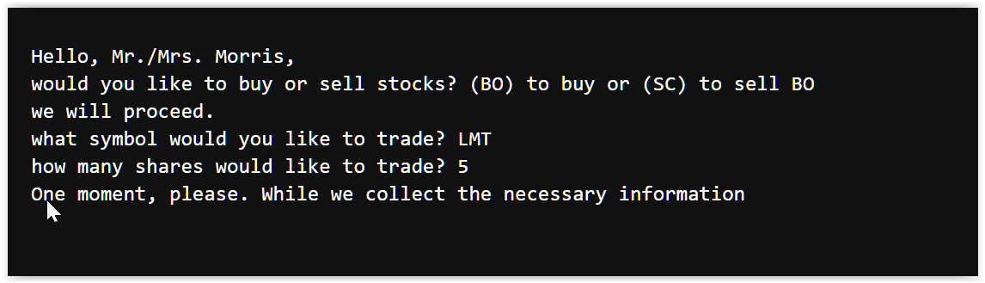
Application interaction
The application requires a login to keep information safe.
It takes advantage of databases to store persistent data and historical data

Slide 7
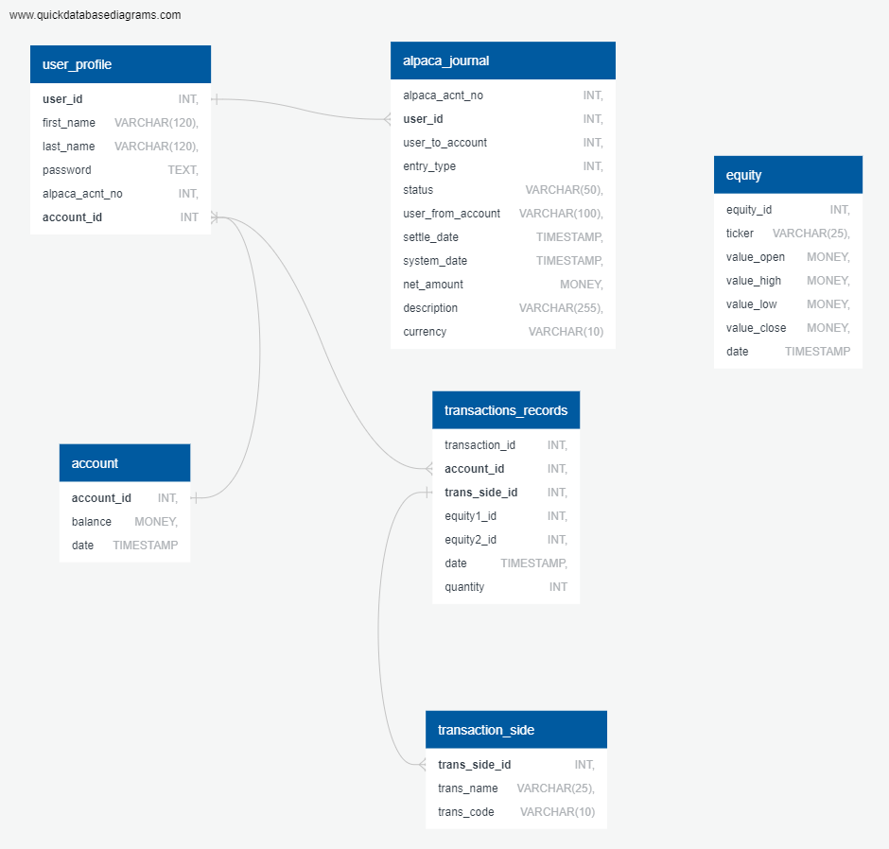
By using a relational database such as SQL, We maintain the ability to easily increase the functionality of the application, store any type of data we need to handle and retain a high level of security of the information we handle

Slide 8
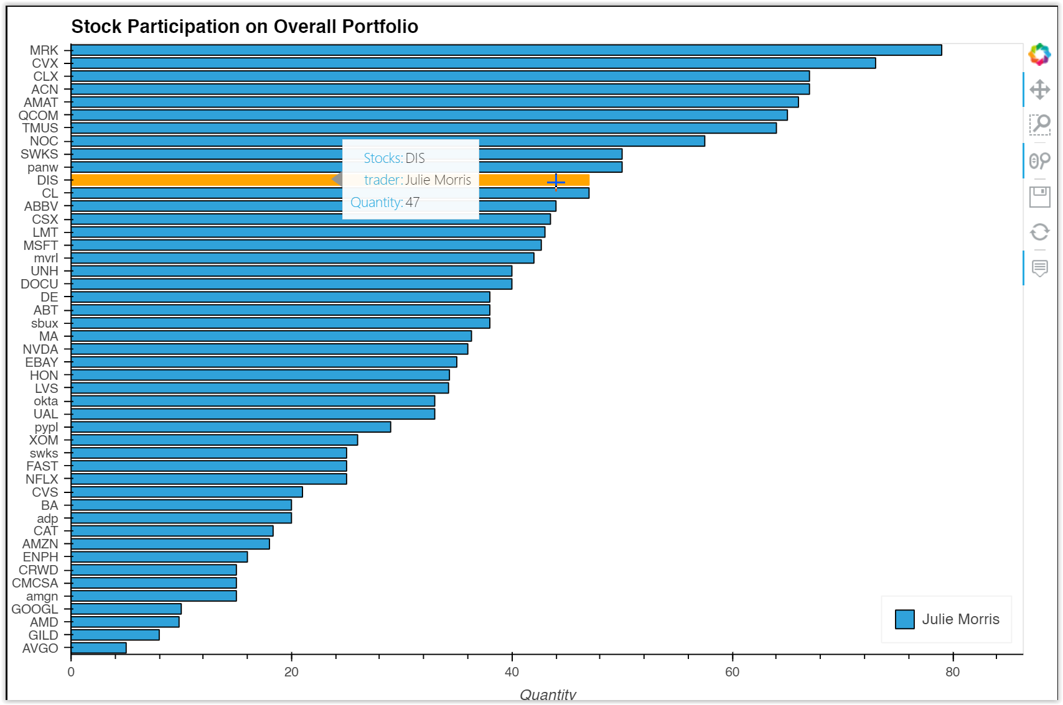
This is the plot of all the stocks in the portfolio
In this chart you can see the participation of each stock and compare to the rest of the stocks in a single portfolio

Slide 9
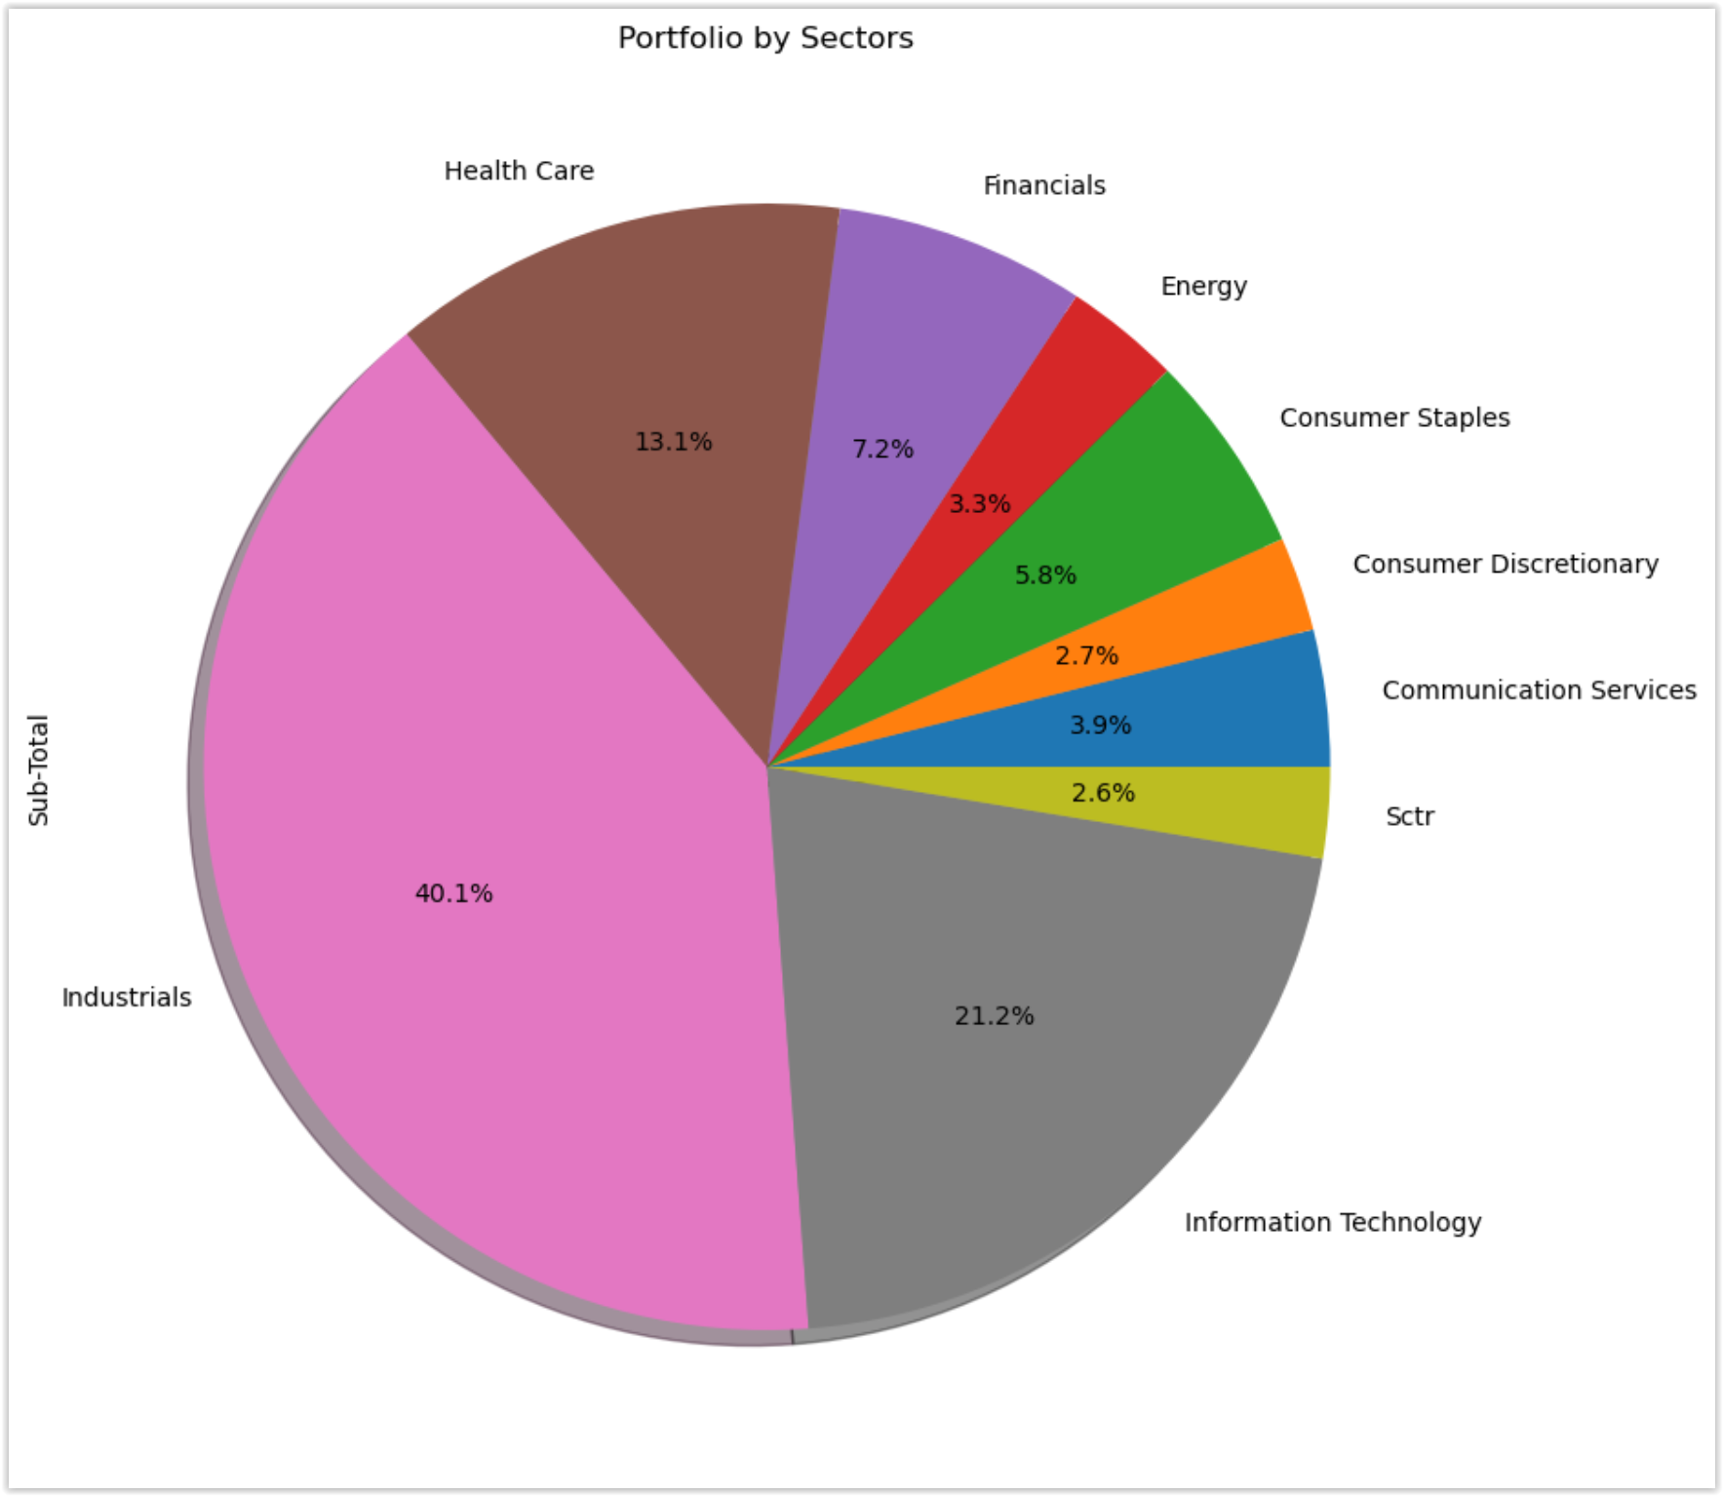
This graph shows the user how the stocks are distributed among the different sector of the market
This allows the user to analyze if the distribution is appropriate according to its expectation or market sentiment.

Slide 10
Stock Analysis For User
User – Sheila
Graphs and Charts Below
Sheila wants information on AAPL and AMZN stock. This curiosity arose from her unbreakable bond with her iPhone and the high monthly tab she runs up from the convenient shipper, Amazon. This led to her being interested in becoming more than just a consumer.
Daily Returns
Portfolio Risk
21-Day Rolling Standard Deviation
Exponentially Weighted Averages
AAPL and AMZN Beta
Sharpe Ratios

Slide 11
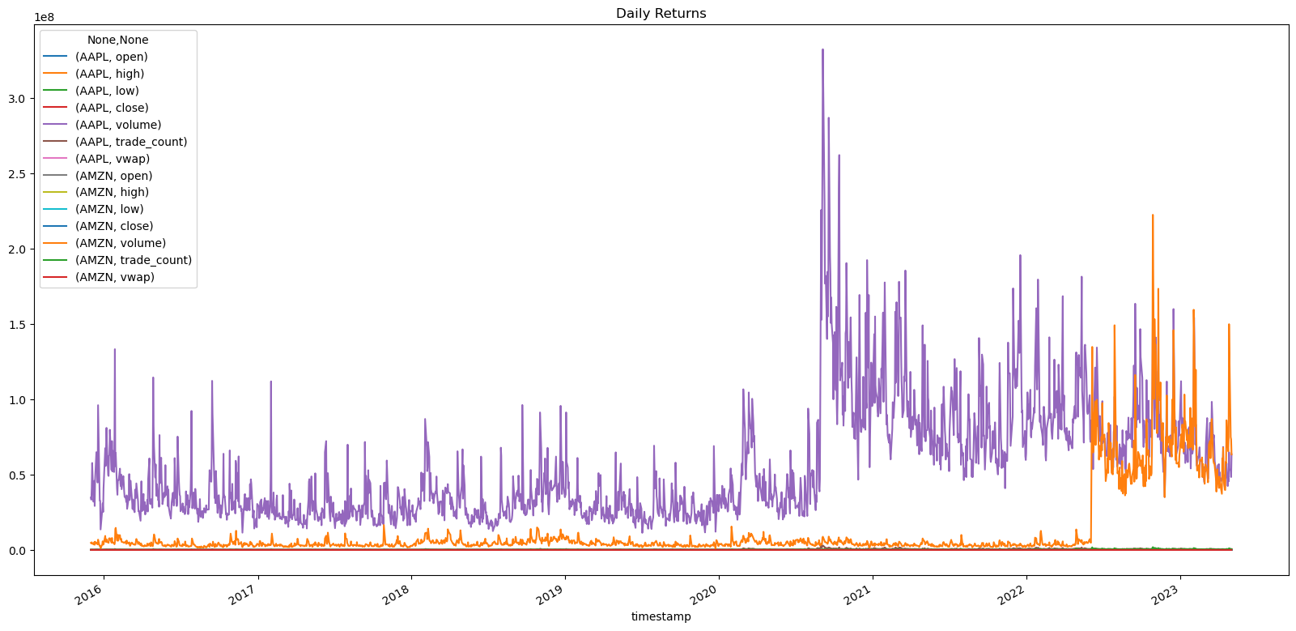

Slide 12
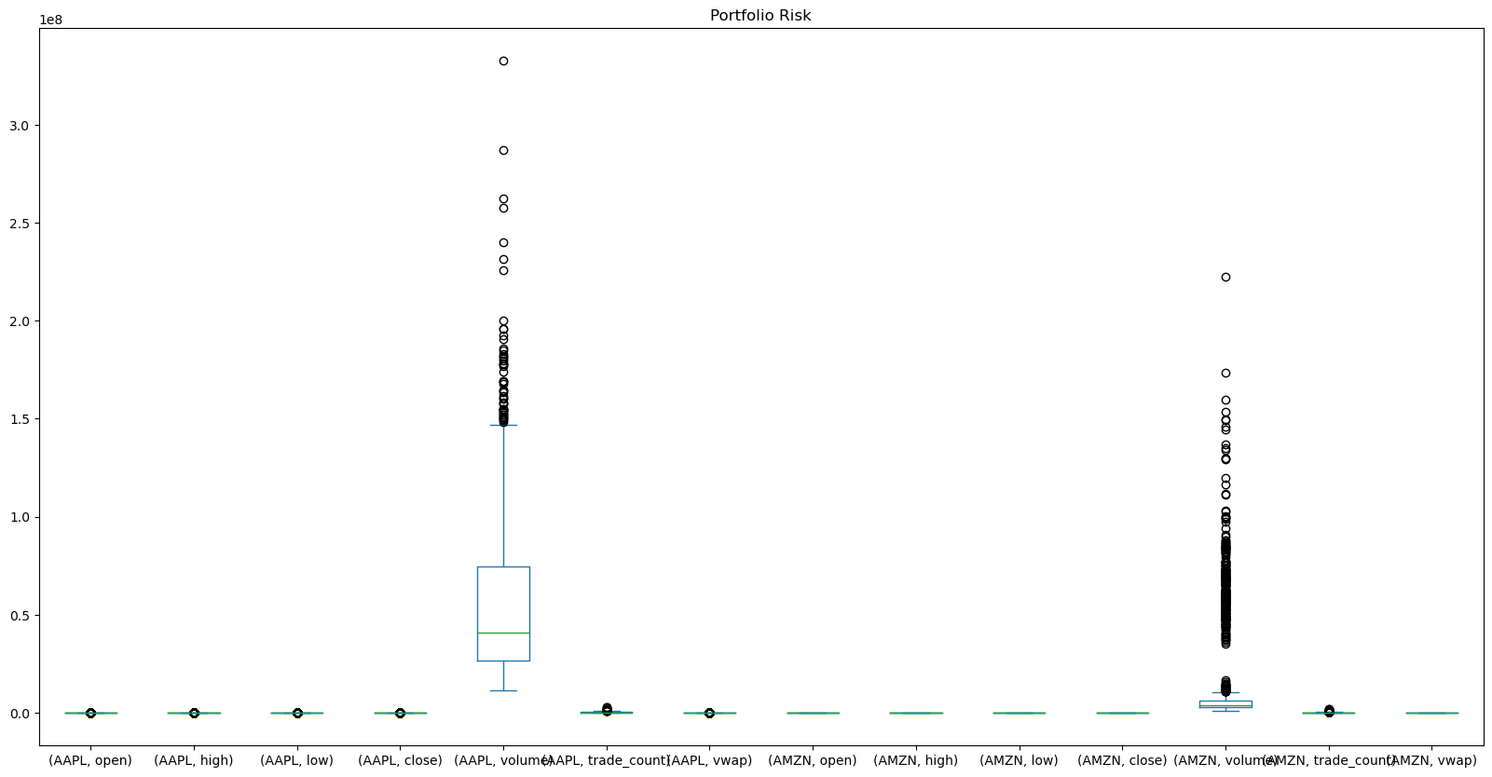

Slide 13
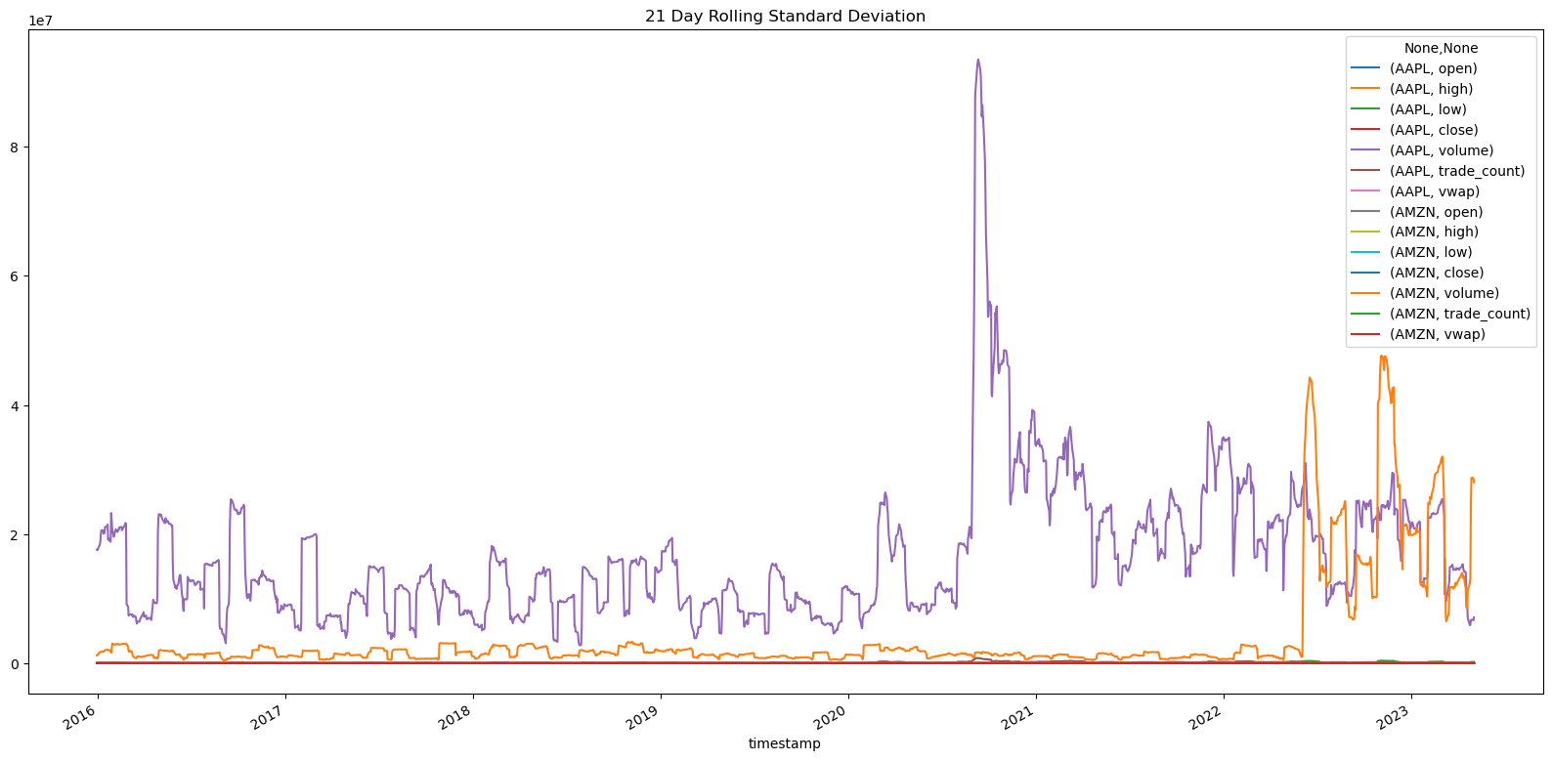

Slide 14
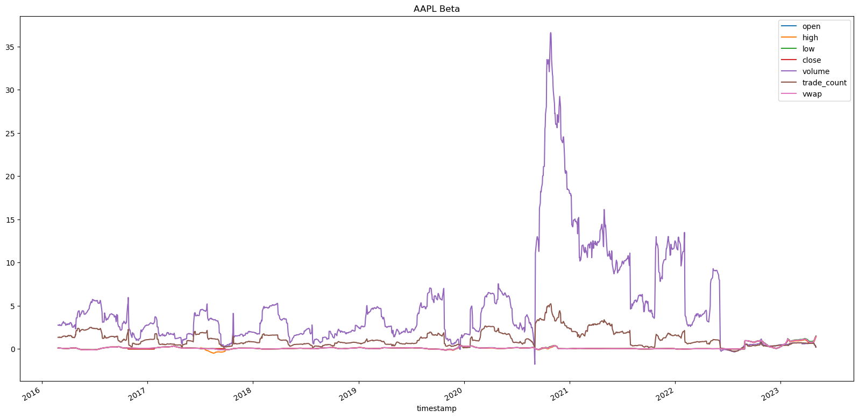

Slide 15
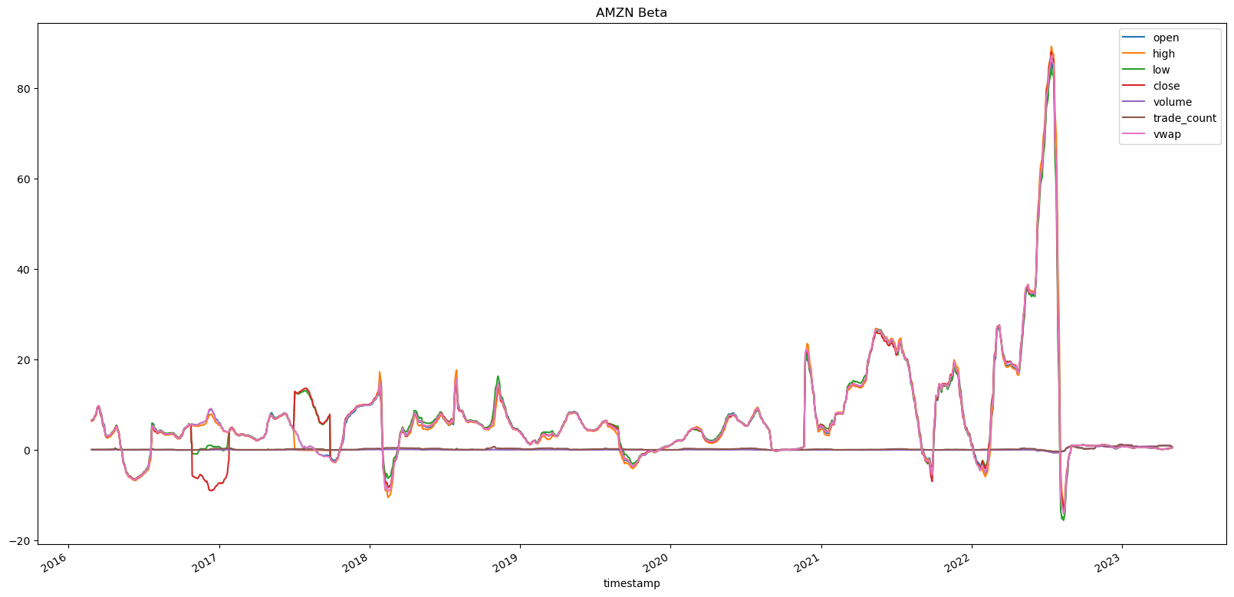

Slide 16
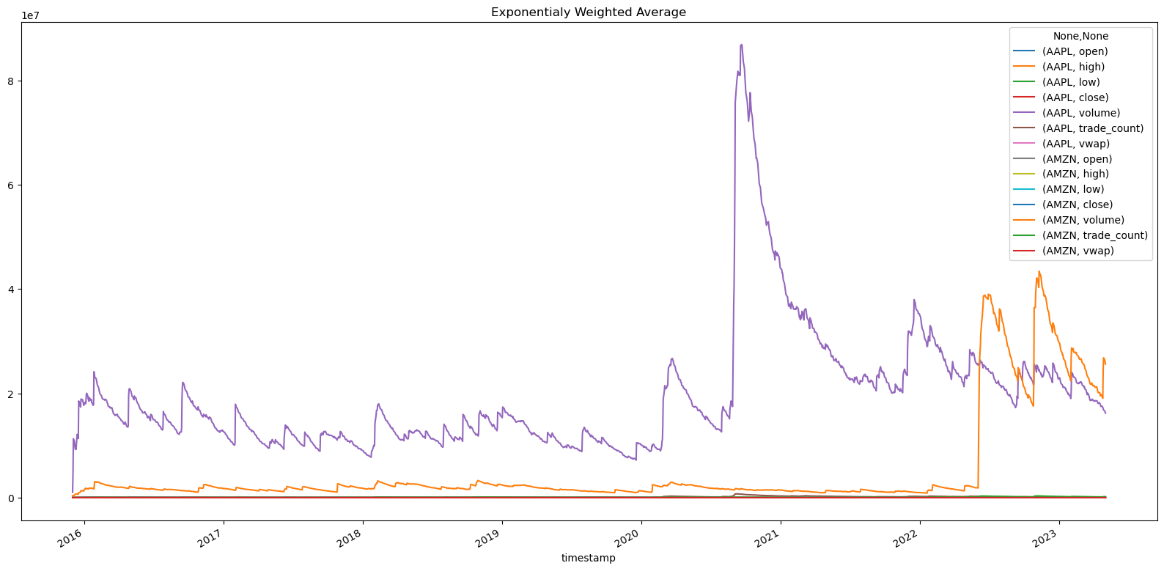

Slide 17
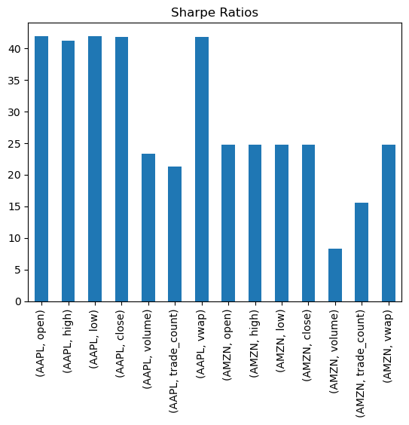

Slide 18
Sector performance
Summary
Presentation of the S&P 500 sectors
Demonstration of each sector performance and highlighting the defensive sectors vs the riskier (risk-on) sectors

Slide 19
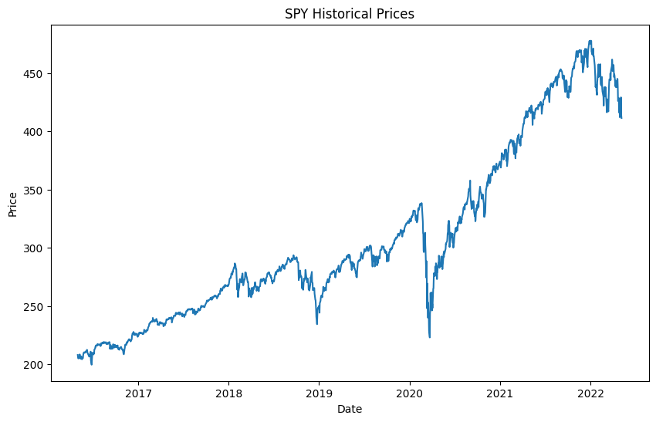
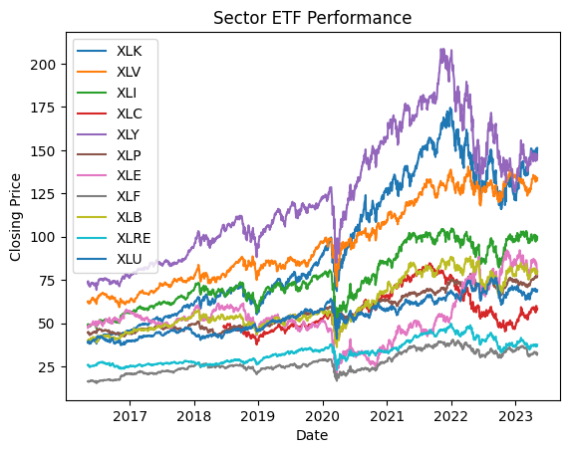
Market Data
These graphs show the performance of the SPY and each sector ETFs
The average rate of return for the S & P for the last 10 years is 10.41%

Slide 20
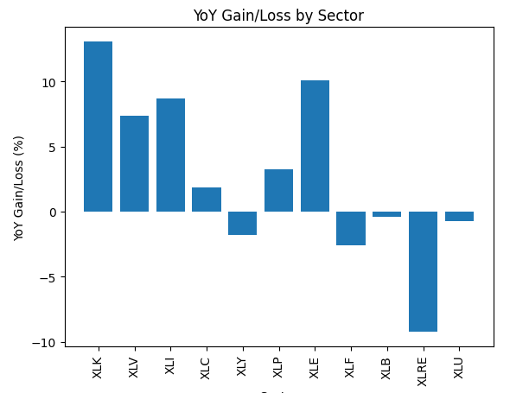
Past year performance
Yoy Gain/Loss 52-Week High 52-Week Low
XLK
XLV
XLI
XLC
XLY
XLP
XLE
XLF
XLB
XLRE
XLU
13.06%
7.40%
8.70%
1.85%
-1.79%
3.28%
10.08%
-2.56%
0.39%
-9.24%
0.73%
151.24
135.66
103.25
59.90
149.54
77.5
87.23
35.84
84.23
38.58
69.97
135.22
123.67
96.27
52.12
137.78
70.77
76.18
30.83
75.18
34.62
63.46
As you can see it is, it is important to have a
diversified portfolio

Slide 21
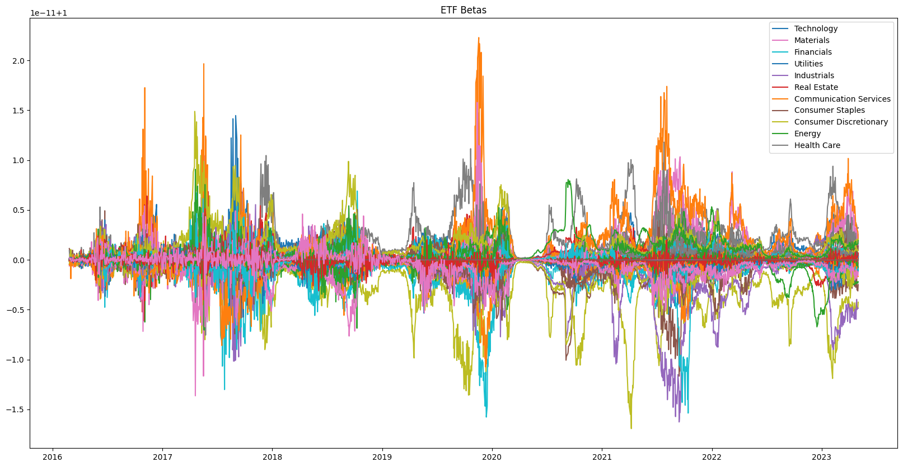
This graphs represents the volatility of each sector in relation to the S & P 500 over an 8 year period
Communication Services and Technology are the most volatile
Utilities and Healthcare are the least volatile
At times when the market is rocky the less volatile tickers can be used as a defensive strategy
Stocks that are more volatile can provide a higher reward but the risk is much greater
`

Slide 22
Historical volatility
29.21%
16.93%
21.26%
28.95%
30.72%
16.47%
33.42%
23.22%
24.16%
25.22%
21.65%
XLK
XLV
XLI
XLC
XLY
XLP
XLE
XLF
XLB
XLRE
XLU
This is an annualized one standard deviation of the stock prices that
measures how much past prices have defeated from their average over a period of time.
The hire the percentage, the more volatile the ticker.

Slide 23
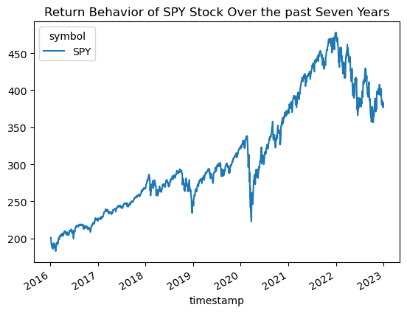
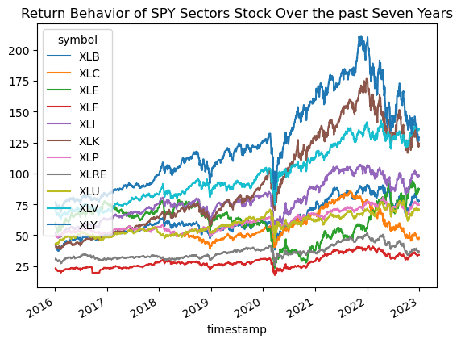
S&P 500 7 Year Return Summary
Summary
Over the past 7 years the S&P 500 has doubled in returns
Top performing Sector has been the XLB(Materials Select Sector)
Presidential cycles have correlation to Sector performance

Slide 24
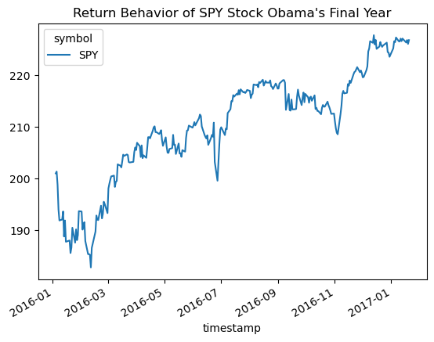
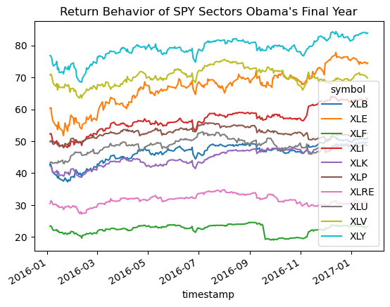
Obama Term
XLY outperformed in Obama’s final year
Consumer names brands

Slide 25
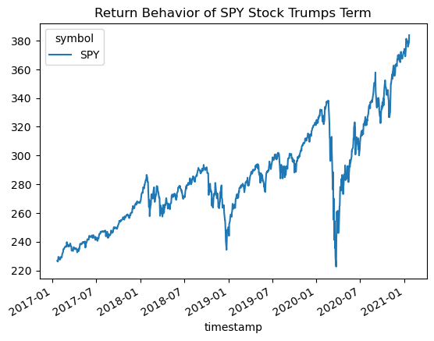
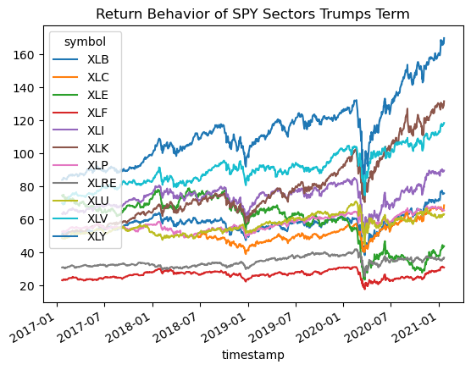
Trump Term
XLB outperformed all 4 years
Materials sectors

Slide 26
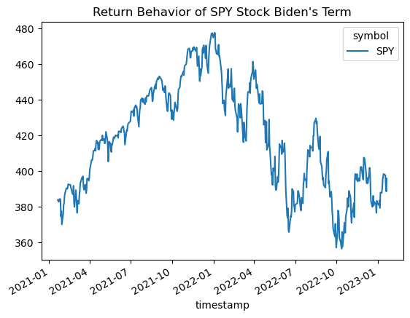
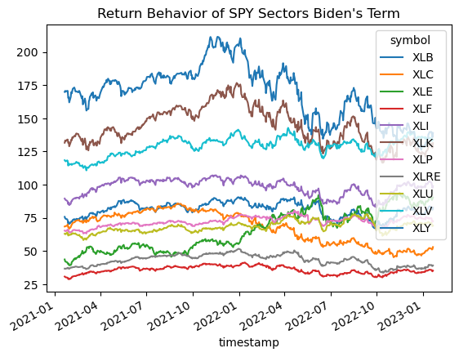
Biden Term
First 2 years all sectors have underperformed
XLB is still the leading sector

